Slide 1

The Lakeside Companies
100 MW - 400 MW
Green Electrical
24x7 From Recycled Wood Mulch

Slide 2
Permanent Steam Powered Turbines
Online @ 18 mos.
Phase 1 Data Center Campus of 4 Phases
Data Center Revenue Investment Opportunity
Pyrolysis & Syngas Revenue Investment Opportunity

Slide 3

Target Market
Who are the likely Tenants:
Lakeside Renewable Products has no competition; Why?
AI Data Service Providers that want a Zero Carbon Footprint !!!!
100 Mega Watts 24/7/365 Green Electrical Supply Now!
Our tenant is not dependent upon Duke Power Grid. !
Market is in the Trillions of Investment dollars.
Wall Street Journal 10/5/25; 9/25/25; 9/1/25
Virtually all Data Centers are dependent on Grid Sourced Electric Supply.
What is the market size right now?
Why is Lakeside Renewable Products, LLC. the safe bet?
Cap - Ex Cost are minimized by a huge investment returns.
We have no Grid Interconnect Backlog
Green Electrical supply is the advantage we bring to our centers!!!

Slide 4
The Trade Partners for Power Generation
Why is this important?
We are talking about a lot of moving parts; logistics that require experience and a lot of your money !!!!!
We are partnering with the Energy Industries’ very best.
Delivery in 14 to 18 months: FOB Wilmington, NC
Kerone Industries: 50 Mega Watts each; Steam Turbines: True Redundancy

Slide 5
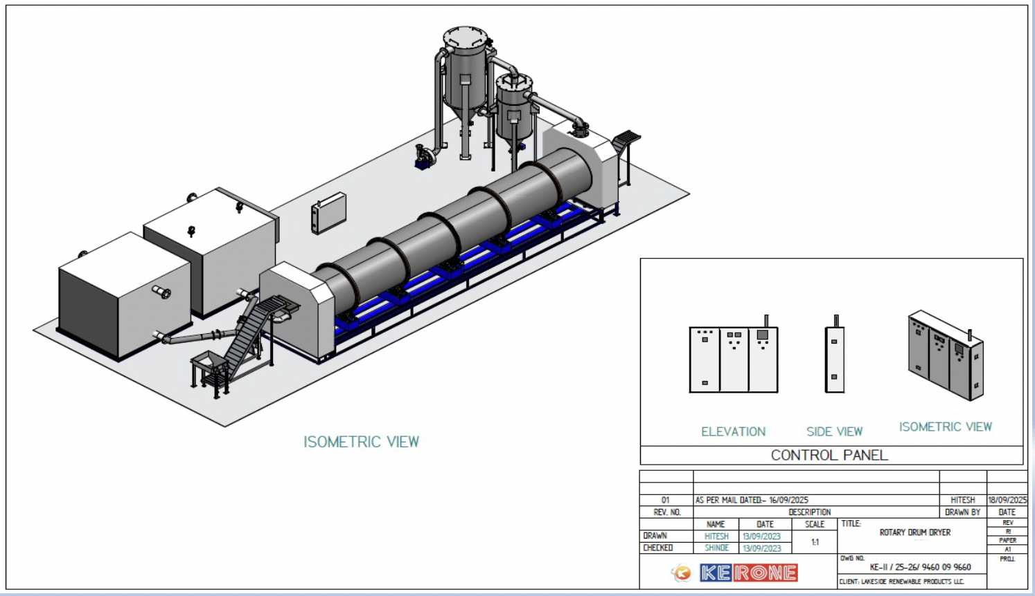
Who are the Trade Partners for Pyrolysis:
Why is this important?
Again; a lot of moving parts; logistics that require experience and a lot of your money !!!!!

Slide 6
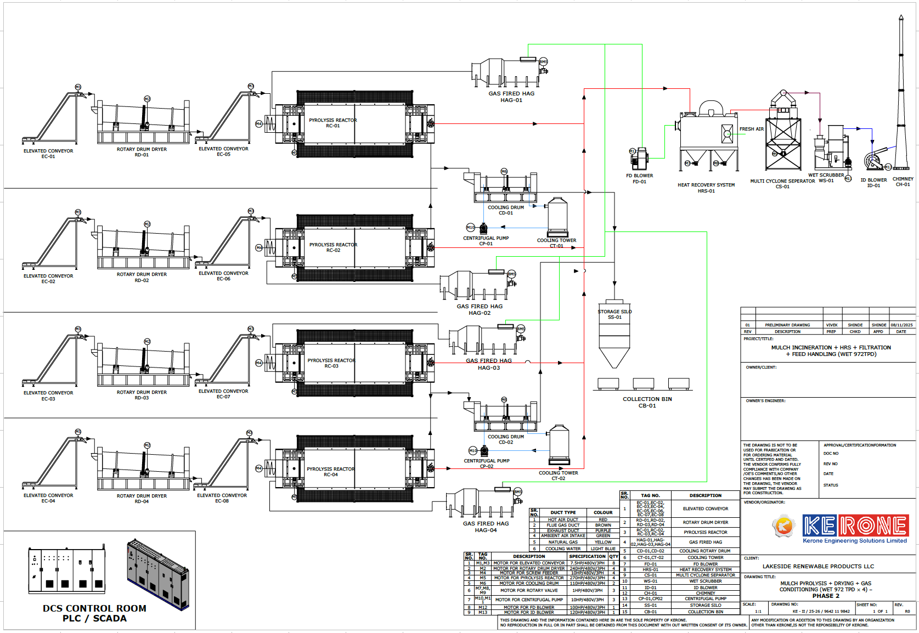
Data Center Renewable Electrical Generation

Slide 7
Entitlement Currently In Process
100 Mega Watts Renewable Energy (RNG) Renewable Natural Gas (Renewable Energy Certificate Compliant)
Production Site Permits in hand: (MCDOW-2026-0134 & NCC252099) Approvals include: McDowell County; Grading; Erosion; & Hydrology Issued on 7/16/25 Air Quality is in process. Issuance during Horizontal Work.
RNG Sourced via Hurricane Helene Debris. Pyrolysis created Syngas: Renewable Natural Gas (RNG) and Bio-Char.
Pyrolysis: High Heat in an Oxygen deprived Environment.

Slide 8
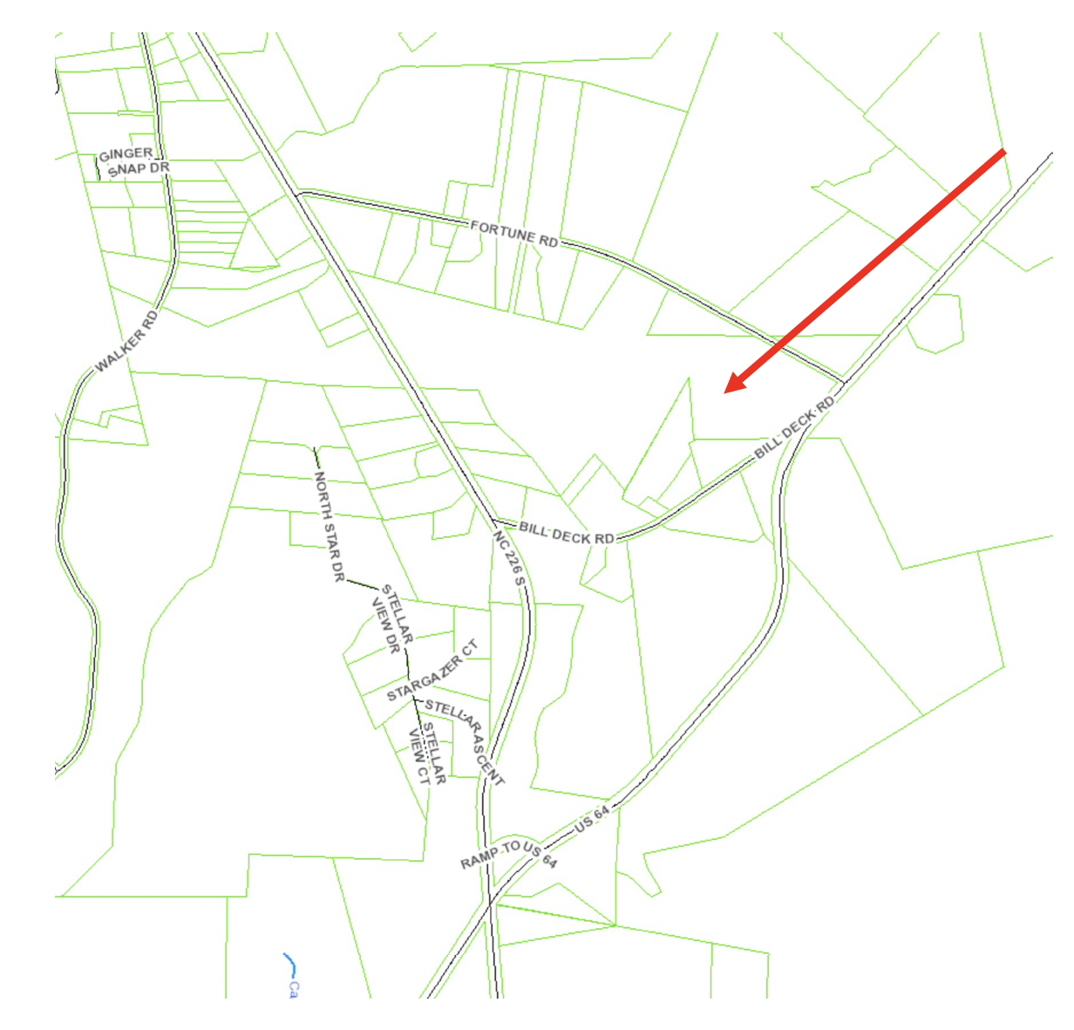
Our Site
South East McDowell County, NC
Approx. 12 minutes south of Marion.
35.584675, -81.838624

Slide 9
Market Durability
All Data Center Production is backlogged due to Electrical Supply Challenges.
Our Renewable Electricity Generation will be produced with Redundancy in mind.
Feed Stock is Hurricane Helen forestry damage. Thousands of acres of forest damaged.
USDA: Active Forest Management Strategy:
The USDA has initiated a program to stream line US Forest Management and Expand National Forest to harvesting.
Our Feed Stock supply chain will be greatly enhanced as the Forest Devastation is harvested.
We will harvest downed Trees and convert them to Renewable Natural Gas. This removes CO2 which is otherwise released into the atmosphere.

Slide 10
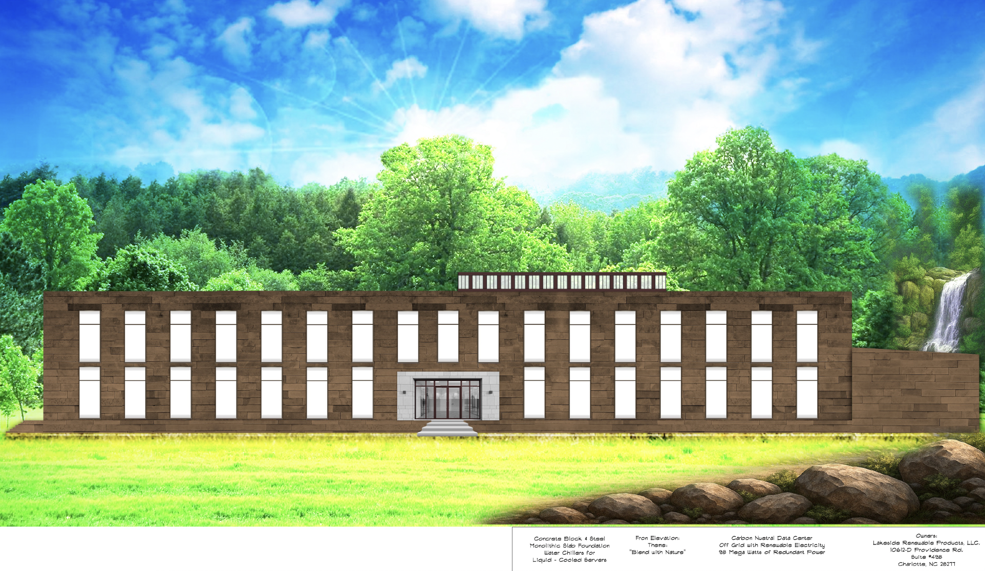
AI Data Center: Facility #1

Slide 11
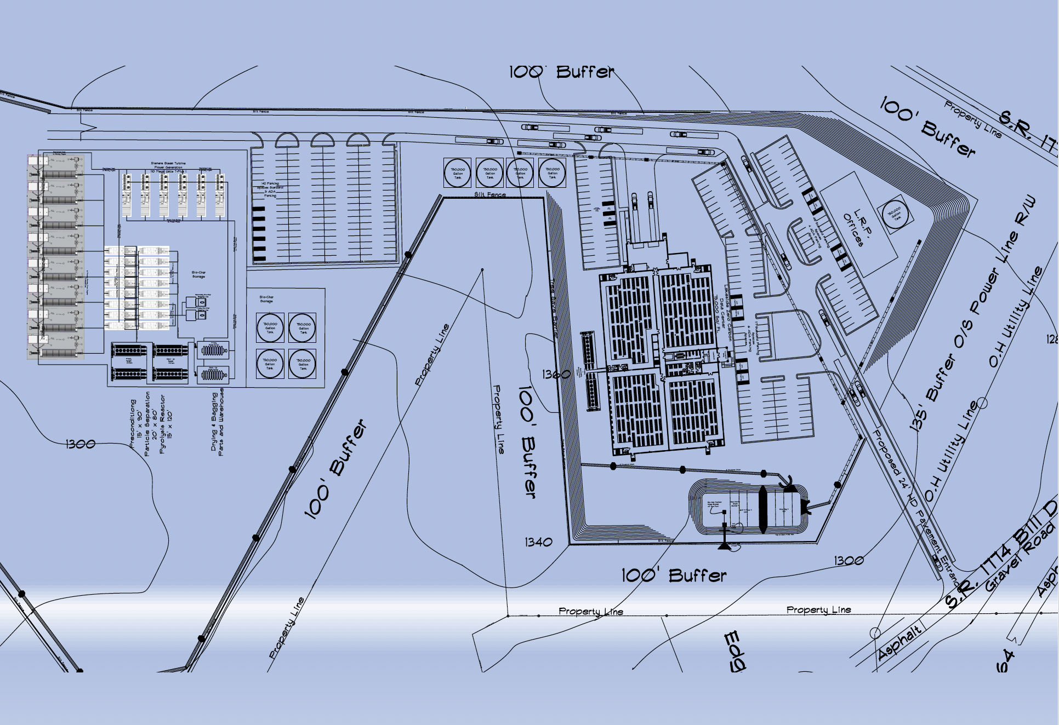
Lakeside Green Power Data Center Site:

Slide 12
Management
We are a company with 155 years combined multi faceted experience.
Our backgrounds range from Business, Heavy Construction, Renewable Natural Gas Development, and Management as well as Environmental Biology.
We are business executives who come together to make our world a better place.
Environmental Stewardship through Renewable Energy Development.
Mr. Mick El-Massri
President and Managing Member
Renewable Energy Developer; Builder and Contractor
Mr. Joe El-Massri
CEO and C/O & Member
Land Developer; Builder and Contractor
Mr. Thomas Getz
Masters of Biology: Staff Biologist
Renewable Energy Developer
Mr. Maurice Soque
BA Finance
CTO Business Development

Slide 13
Thanks
The Lakeside Companies
Lakeside Renewable Products, LLC.
10612-D Providence Rd. Suite #498 Charlotte, NC 28277
704-996-2631

